Slide 1
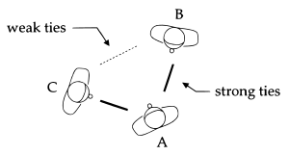
The Strength of Weak Ties
The musings of James Cracknell on the paper discussing the implications for networks of weak ties
Granovetter, M.S (1973) ‘ The strength of Weak Ties’, American Journal of Sociology. University of Chicago Press, 78(6), pp.1360-1380. doi: 10.1086/225469

Slide 2
Most of the research to date focuses on strong relationships

Slide 3
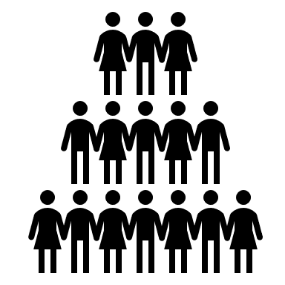
Degree of overlap in ‘friendship networks’ depends upon the strength of tie between the two
A
B

Slide 4
Current weakness in sociological thinking around networks is that ‘micro-level’ interactions ‘do-not’ impact ‘macro-level’ behaviours in a convincing way

Slide 5
Interpersonal networks are at their most fruitful when there is a bridge between the micro and macro activity. Small interactions lead to large scale interactions in a virtuous spiral.

Slide 6
The focus of the paper is on ‘Interpersonal ties’ – how they impact upon diffusion, social mobility and social cohesion. Strength can be thought of as “ a (probably linear) combination of the amount of time, the emotional intensity, the intimacy (mutual confiding), and the reciprocal services which characterize the tie” p.1361 A network acts as a complex adaptive system – these relationships are interconnected and dependent upon each other, they are also highly dependent upon levels of trust. What causes events to occur is dependent on the trust within and between each node. From this definition we can make the judgement of a strong, weak or absent tie to a friends network. The paper assumes that ties are positive and symmetric so as to avoid the complexity of including negative / asymmetric bias into the analysis.

Slide 7
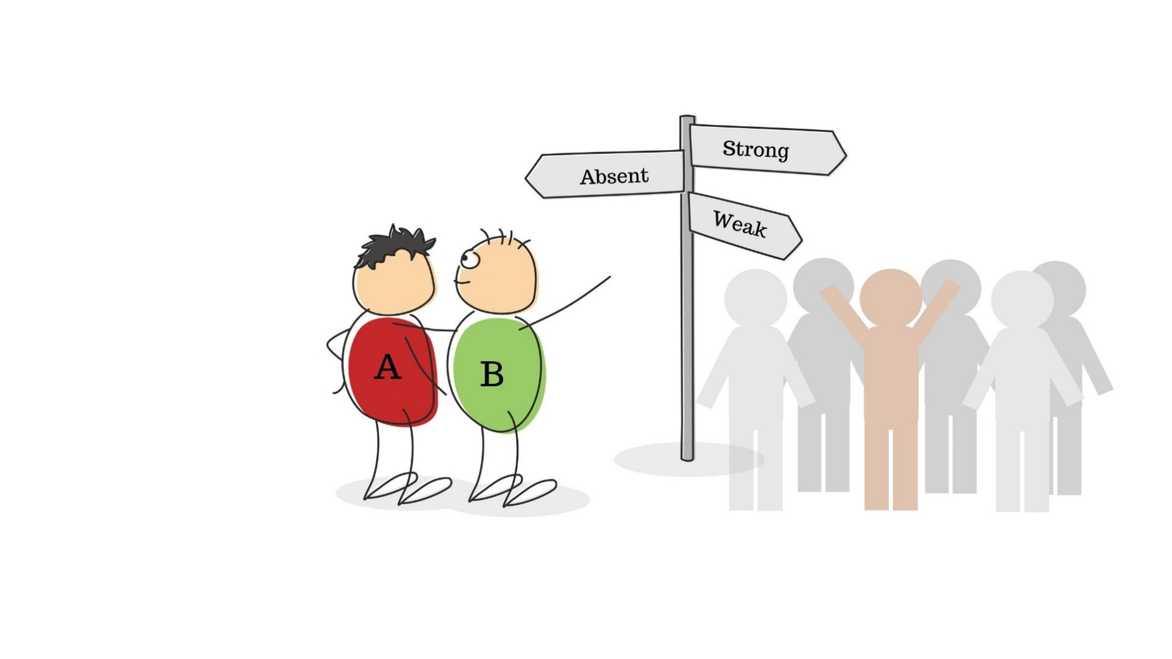
Two random people – each with a set of friends. When the tie between the two is weak, the overlap is predicted to be intermediate, when it is absent, the overlap is predicted to be zero, and when it is strong, the overlap is predicted to be many.

Slide 8
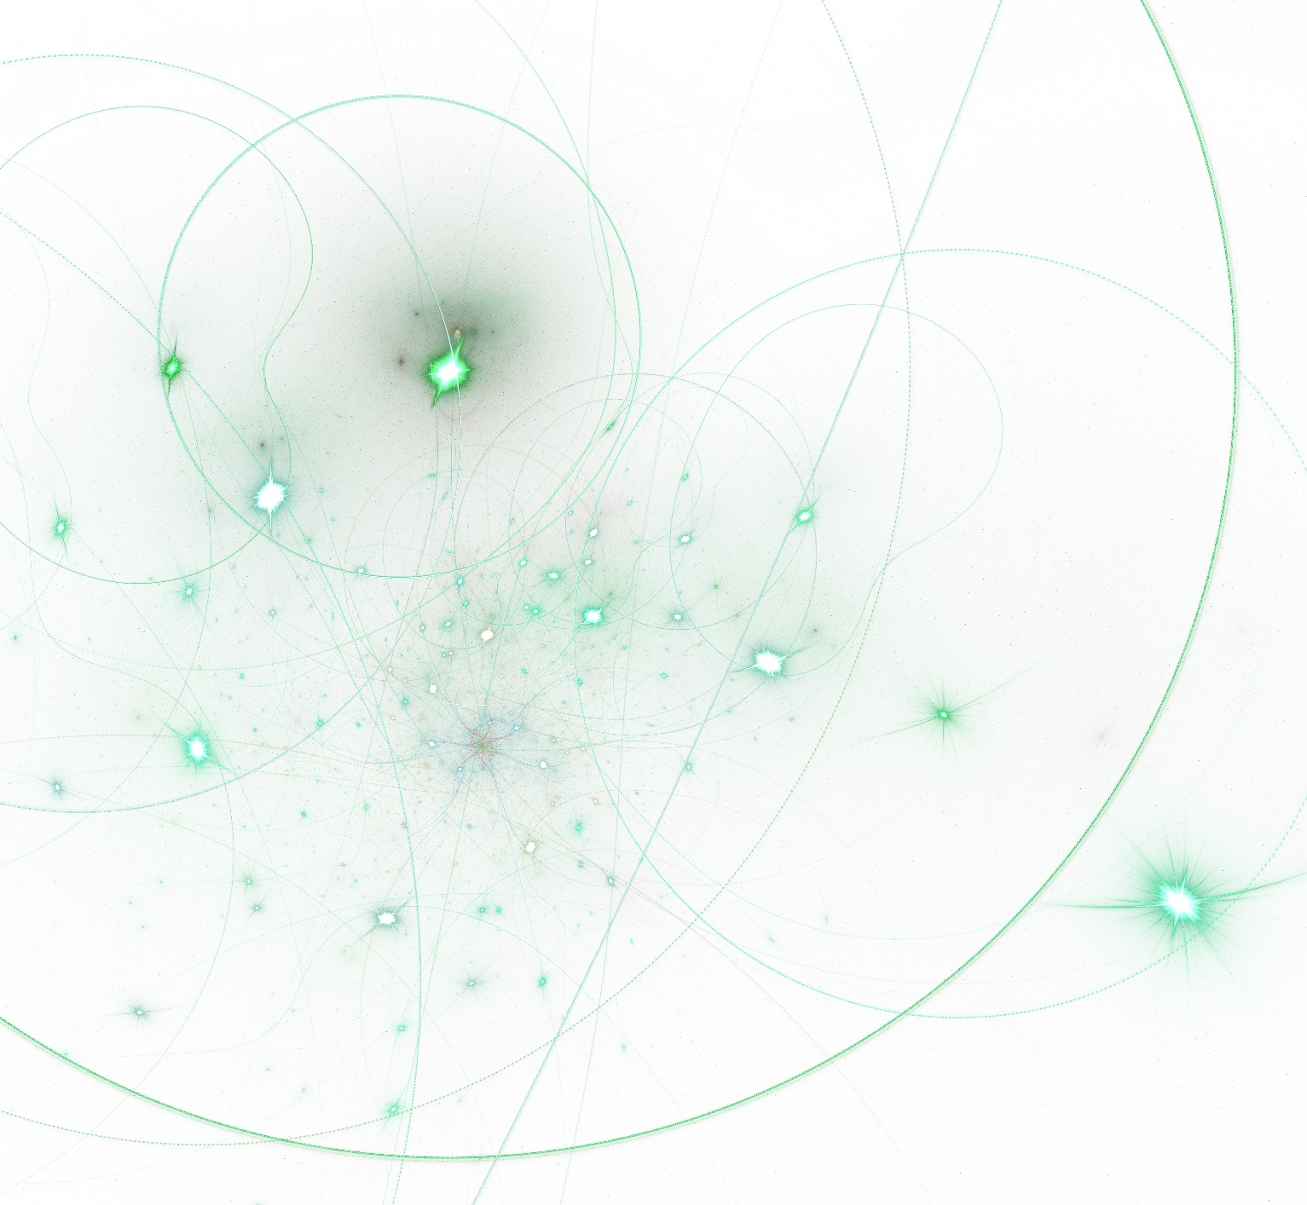
The strength of interactions, the depth of friendship between people, are dependent upon a number of factors but implicit to this is how often they interact. The author further contends that “if strong ties connect A to B and A to C, both C and B, being similar to A, are probably similar to one another, increasing the likelihood of a friendship once they have met.” p.1362 The two elements of time and similarity are primary determinants of interactions between each of the friends.

Slide 9
Cognitive balance, as formulated by Heider in 1958 and Newcombe in 1961, suggests that when ties are strong and positive the relationships between ‘A and B’ and ‘A and C’ and ‘B and C’ perform well in terms of cohesion and therefore diffusion. If incongruences should emerge between ‘B and C’ say and assuming ‘strong ties’ it would introduce ‘psychological strain’ into the situation. This strain would be far less evident if the ties are ‘weak’ – therefore we might conclude that to lower risks of a breakdown within the network we need to foster ‘weak’ ties rather than invest in building strong?

Slide 10
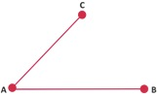
Weak ties in the diffusion process To test the implications of the notion that weak ties are supportive of diffusion we need to frame the thinking. If A and B have strong ties, then C is a random friend of A or B. Under these conditions that the probability that B and C share zero connections is not great. This absence of ties is what is termed as “the forbidden triad”. “The significance of this triad's absence can be shown by using the concept of a "bridge"; this is a line in a network which provides the only path between two points” p.1364
Forbidden Triad
This Photo by Unknown Author is licensed under CC BY-SA

Slide 11
“A strong tie can be a bridge, therefore, only if neither party to it has any other strong ties, unlikely in a social network of any size (though possible in a small group)” p.1364
Bridges and their implications for diffusion The authors suggest that the Forbidden Triad, in respect of their argument, should be assumed to never exist. Their observations, based on the analysis of 651 sociograms by Davies back in 1970, concludes that under the condition of absence of the ‘triad’ that the path between two points of any network is reached via a bridge and that bridge is unlikely to consist of ‘strong ties’. Why? Well if A and C share a strong tie and A and B have strong ties then, based on the absence of the ‘triad’ there is a ‘pathway’ between ACB and the bridge does not exist. So if diffusion is to happen then ‘weak ties’ make up the bridge between two nodes of a network.

Slide 12
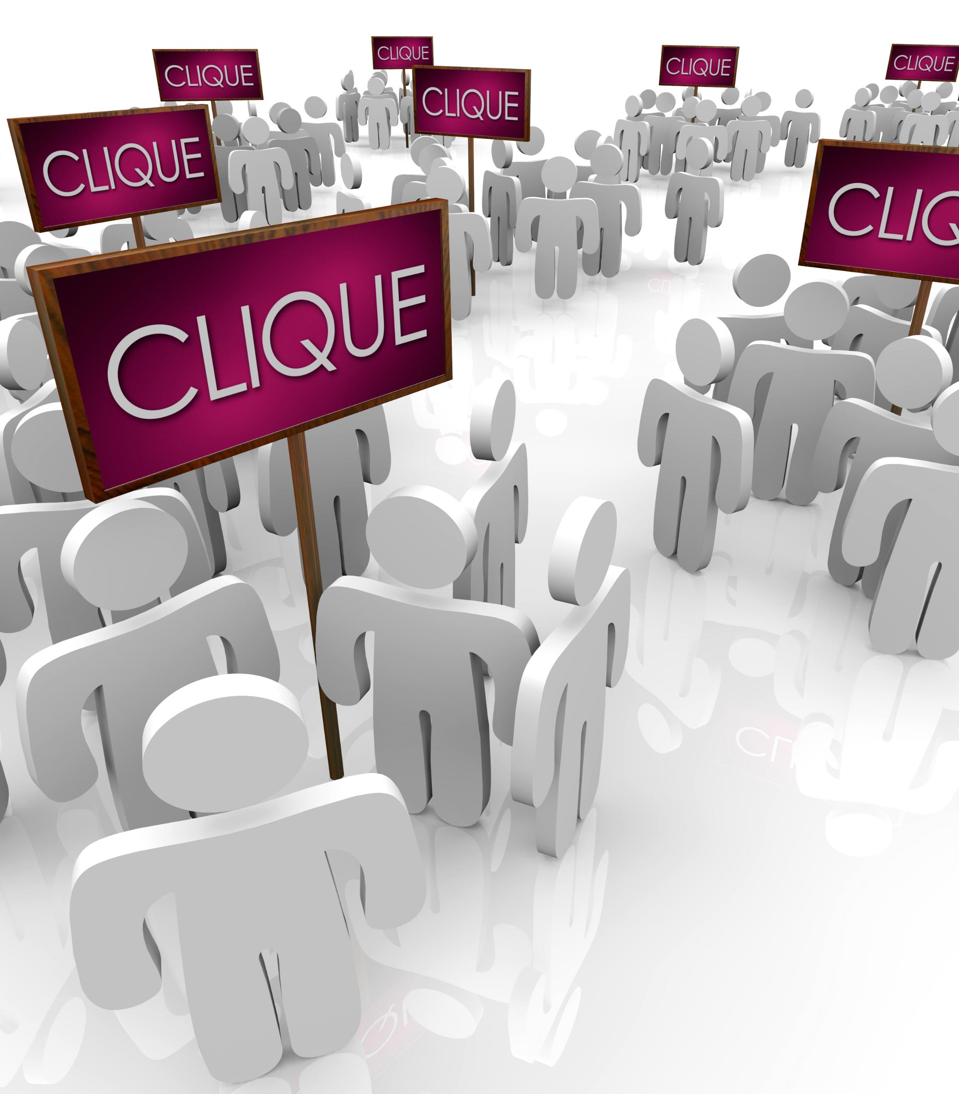
The quality of the transfer of knowledge is inversely proportional to the distance it has to travel and directly proportional to the quality and number of nodes it passes through. Knowing these variables allows us to calculate the probability of success. Local bridges cut down the distance between two points and as with a highways system, when that bridge is the only one around, it becomes well used, essential to the network. Since a bridge is a weak tie, the removal of an essential bridge can reap havoc on the effectiveness of the network to pass on knowledge. Nurture weak ties more than strong one – strong ties lead to the creation of cliques, and cliques are the enemy of diffusion. “If one tells a rumor to all his close friends, and they do likewise, many will hear the rumor a second and third time, since those linked by strong ties tend to share friends. If the motivation to spread the rumor is dampened a bit on each wave of retelling, then the rumor moving through strong ties is much more likely to be limited to a few cliques than that going via weak ones; bridges will not be crossed.” p.1366

Slide 13
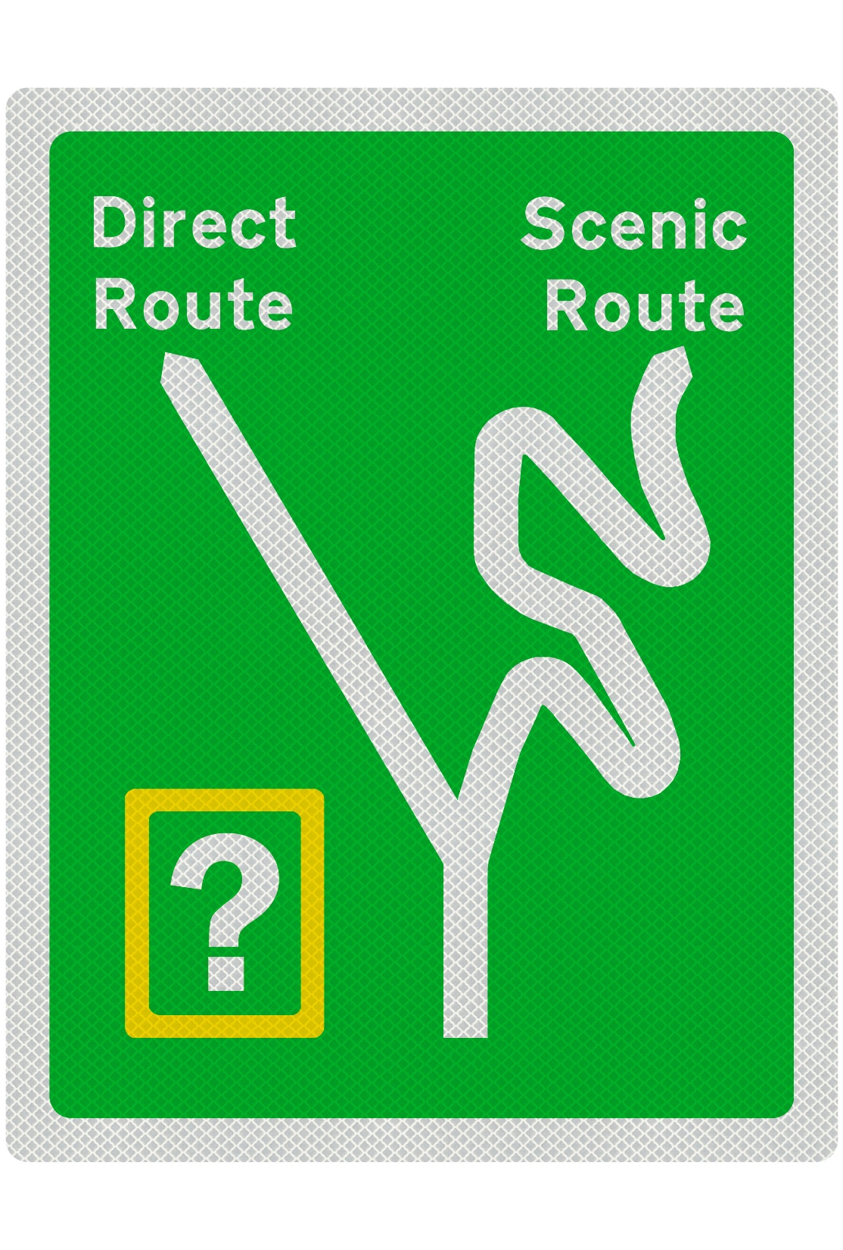
Diffusion only occurs through human interaction and engagement. Sociometrics tend to avoid measuring weak ties and instead focus on the role hubs play in the way innovations / ideas are absorbed. Diffusion tends to be measured in terms of time to adoption and stages in which innovations pass rather than the specific roads travelled. As with a car navigation system, speed of arrival is the clear winner over the perhaps more engaging scenic route. If ideas and innovations only travel with expediency then they are far less well formed than those which engage with their environment. “More commonly, the time when each individual adopted the innovation is recorded, as is the number of sociometric choices he received from others in the study. Those receiving many choices are characterized as "central," those with few as "marginal"; this variable is then correlated with time of adoption and inferences made about what paths were probably followed by the innovation.” p.1366

Slide 14
The authors contend that ‘early innovators’, those who engage with innovations at the start of diffusion are not representative of the norm or segment where the innovation is most relevant. This has two implications if true, the first, if these groups are isolated from the others, how does diffusion occur, and secondly, if they are not representative of the norm then should our persona analysis change for radical innovations? The concept of radical innovation in this context is innovation that if adopted creates a risk to reputation of the person who engages with it. Early innovators are risk tolerant whilst early adopters are less so. This tenet was tested through a case study called ‘hysterical contamination’ where a factory was eventually closed down because people were under the assumption that there was a dangerous insect inflicting bites on employees. The rumour was started by 6 women – when quizzed they were asked about strong friendships they had in the factory. The list was small or even non-existent, they were socially isolated and not even connected to themselves. Yet their complaint eventually registered with the wider community and many more people developed the symptoms. A second set of interviews were created and this time the focus was on weaker connections, car-shares, ad-hoc meetings at the drinks dispenser etc. The increase in weak tie activity eventually explained how the diffusion spread. If “resistance to a risky or deviant activity is greater than to a safe or normal one, a larger number of people will have to be exposed to it and adopt it, in the early stages, before it will spread in a chain reaction. Individuals with many weak ties are, by my arguments, best placed to diffuse such a difficult innovation, since some of those ties will be local bridges.” p.1367

Slide 15
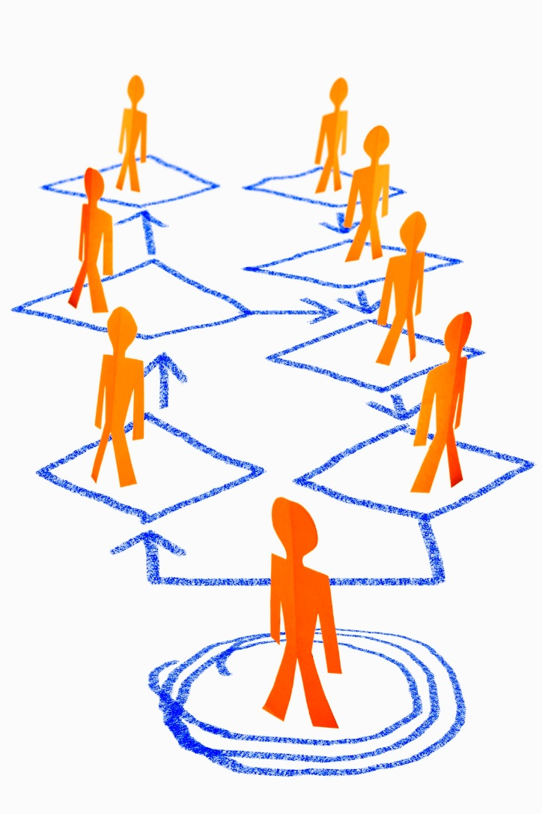
WEAK TIES IN EGOCENTRIC NETWORKS It is clear that networks do indeed constrain as well as shape who we are. Our behaviours are often determined by the people who surround us. If we want to improve ourselves then we need to surround ourselves with people who inspire us to do more. Networks are dynamic, they change when new people arrive and when new people leave, we can manipulate them by inviting people in, by seeking to create the opportunities we believe need to be created. One way we can measure the effectiveness of a network is through its density – a value that is calculated by taking those who we have strong ties and dividing this number by the ‘potential’ of the network. Ego networks have different densities within their overall density, that is the top quartile known as the ‘effective network’, because it consists of strong ties may be more dense than that of the weaker bottom quartile or our ‘extended network’ full of weak ties. We could even think of the density of a network in terms of bridges. “In the "weak" sector, however, not only will ego's contacts not be tied to one another, but they will be tied to individuals not tied to ego. Indirect contacts are thus typically reached through ties in this sector; such ties are then of importance not only in ego's manipulation of networks, but also in that they are the channels through which ideas, influences, or information socially distant from ego may reach him.” p.1371

Slide 16
Networks and recruitment It has long been known that recruitment through ones network rather than through the more ‘obvious’ agency routes is a common feature of today – but it was also a common aspect of the last century. Our strong ties are more invested in us to help us stay in work but it the weaker ties, those that operate in different domains where opportunity truly lies. The frequency of engagement is a measure of the strength of the tie, and the authors defined these into a frequency of contact: “often = at least twice a week; occasionally = more than once a year but less than twice a week; rarely once a year or less.” Their analysis showed that those finding a job through contacts said 16.7% were ‘often’, 55.6% said ‘occasionally’, and 27.8% ‘rarely’ with a skew in the results that indicate the weak end of the continuum, suggesting that the network structure offers greater opportunity for manipulation than that of personal motivations. The primary criticism of this is that the measures of frequency are too broad to truly engage with that, most of our engagement with the networks would naturally fall into the ‘occasional’ category. With the rise of social media and especially LinkedIn we also have different ways of warming up ties so that they do not fall neatly into the category of weak or strong, the continuum has more granularity than names allude to. But even in the 1970’s, well before social engagement was on a scale that we have now the authors made this observation: “It is remarkable that people receive crucial information from individuals whose very existence they have forgotten.” p.1372

Slide 17
In the world of social mobility we can question the existence of social cohesion. The role of weak ties has never been so significant to the presentation of opportunity and where opportunity is acted upon, so social cohesion occurs. As we become more fluid in the jobs we perform we cross into different industries and by doing so we increase the flow of knowledge from one cluster to the next. Why is open access so important to cluster creation? For this very reason, every entrant builds a bridge, every bridge acts as a pathway to a new set of networks and ideas are recontextualised to a different domain. Those transitioning don’t do so alone they bring with them a whole host of nodes that start to be seen and engaged with by others. “Information and ideas thus flow more easily through the specialty, giving it some "sense of community," activated at meetings and conventions. Maintenance of weak ties may well be the most important consequence of such meetings.” p 1373

Slide 18
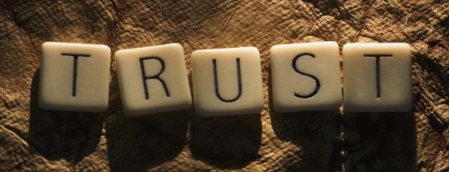
WEAK TIES AND COMMUNITY ORGANIZATION
It is a common observation that communities, when united, are vastly more powerful than an individual but uniting communities is fundamentally difficult even when you think they should be united. In the world of mass media communications, the authors observe, that rarely do we act on this mass media unless it is endorsed by those we trust. This goal of breaking down the cliques in order for them to be realigned under one umbrella is neither truly obtainable nor desirable. Change therefore has a greater chance of success if we find ways of operating within each clique in a way that independently unifies them but also then creates synergies between each entity. We build the system one system at a time. The role of trust in carrying the message is vital, therefore knowing where trust comes from and how it is built is manifest to the effectiveness of the network. This comes from a network of lieutenants who act as bridges for leaders to carry their message across.
“Trust in leaders is integrally related to the capacity to predict and affect their behavior. Leaders, for their part, have little motivation to be responsive or even trustworthy toward those to whom they have no direct or indirect connection. Thus, network fragmentation, by reducing drastically the number of paths from any leader to his potential followers, would inhibit trust in such leaders. This inhibition, furthermore, would not be entirely irrational.” p.1374

Slide 19
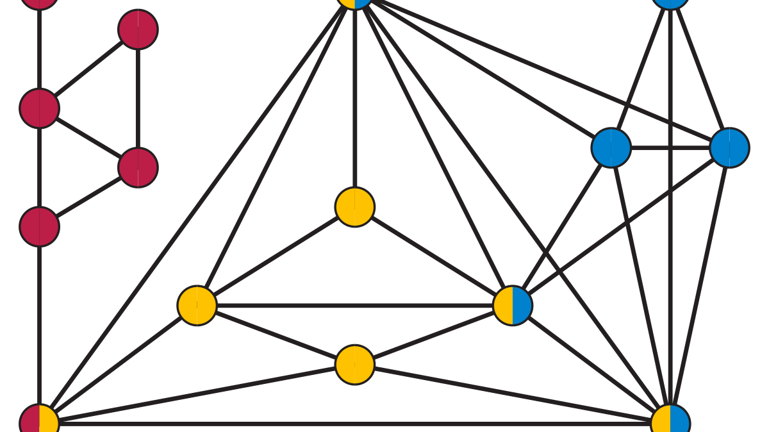
Weak ties without bridges
The authors used an analysis of two Boston communities to consider how ineffectively and effectively each stood up to the urban renewal programmes that, once imposed on them, could eventually destroy their communities.
These regeneration programmes were hard to resist. Both communities were fragmented and despite a common goal, one succeeded and the other failed. The difference was an ability to present a unified voice of resistance. The mechanism for building and maintaining weak ties were absent in one and not the other.
If we imagine a fragmented community in which no cluster was directly connected to another, they were partitioned cliques where diffusion of ideas, of urgency and of validation was denied – trust faced a closed door. The group that failed in creating cohesion did so because they denied entry to an existing clique. One could not identify why this was so from an observational perspective, no obvious points of differentiation were noted. All that could be said was that gaining access was hard, and once access was allowed, the same people were locked into the same behaviours. No obvious weak ties existed. It would be incredulous to suppose weak ties were not there at all – but if those weak ties were not bridges then their ability to connect was truncated. The second community, the one that did hold out did so because the means to create weak ties with bridges was evident unlike the other community “it had a rich organizational life, and most male residents worked within the area”.
In the first community it was observed that "sociability is a routinized gathering of a relatively unchanging peer group of family members and friends that takes place several times a week." Some "participate in informal cliques and in clubs made up of unrelated people.... In number, and in the amount of time devoted to them, however, these groups are much less important than the family.” p. 1374
This Photo by Unknown Author is licensed under CC BY-SA

Slide 20
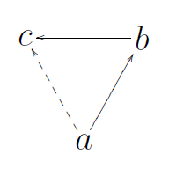
MICRO AND MACRO NETWORK MODELS
The model represented in this paper does not really apply to low level networks represented as small face to face groups, instead the author is looking at broader groups, those say you would find in a Regional Innovation System (RIS). The logic is that weak ties are more likely to connect a disparate, amorphous collection of groups than strong ties, which would be more prevalent in the face to face groups you might find in an organisation or small community.
The author suggests if our interest lies in the later then we should engage with the work of Davis, Holland, and Leinhardt, who together, or individually considered how ‘choices’ are made within groups and how these are based upon the logic of transitivity.
This logic states that “Interpersonal choices tend to be transitive-if P chooses 0 and 0 chooses X, then P is likely to choose X”, follow this logic and we can see the foundation on which cliques are built. As we know cliques are the enemy of diffusion – so small groups choose based on strong ties then the author states, that larger groups connecting must be based upon weaker ties and weak ties are needed for diffusion.
This Photo by Unknown Author is licensed under CC BY-SA

Slide 21
Human interactions are choices based off preference
We chose to spend time with people because we want to, we like their company and they fall into the category of friends. Yet frequency of engagement is far less considered, that is we spend a lot of time at and in work, accordingly we may do things with people we don’t necessarily want to spend time with. Transitivity is therefore something we often think of in terms of cognitive choice rather than enforced behaviours. If we remove choice then status plays a more significant part and we can conclude the strength of the tie, is important in transitive relationships. Who and how we relate to each other depends a lot on the power that each element holds and how that power creates status within the network.
“Transitivity, then, is claimed to be a function of the strength of ties, rather than a general feature of social structure.” p.1377
So the logic of transitivity, according to the authors, is only really relevant in small enough groups. This is so that any person is familiar with any other person to make the judgement of “whether to "choose" him, and encounters him often enough that he feels the need for such a decision.” p.1377 All of which implies that ties are strong. The authors model works because of the prevalence of weak ties in a wider community.

Slide 22
CONCLUSION
The primary messages derived from this body of work is that the micro level of activity and relationships is definitely impactful upon the way the macro social structure develops and impacts networks. Micro-level implies a prevalence of strong-ties whilst macro-level considers how weak ties facilitate the working of the network. This creates some paradoxes, firstly, that weak ties, often considered as the route to alienation are also the catalyst for opportunity. Secondly, how the prevalence of strong ties, seen as the glue that holds together smaller groups, does so at the cost of fragmenting the broader network.
The work has also avoided some of the extraneous issues around why people connect and focused instead on the strength of the ties. Content and the relevancy of the tie matter in the motivations and ultimately the manipulation of the network. The paper states that it focuses on positive connections, those that benefit, but what of negative connections, can they be managed or even be used to strategically modify the network.
“Demography, coalition structure, and mobility are just a few of the variables which would be of special importance in developing micro-macro linkage with the help of network analysis; how these are related to the present discussion needs specification.” p. 1378

Slide 23
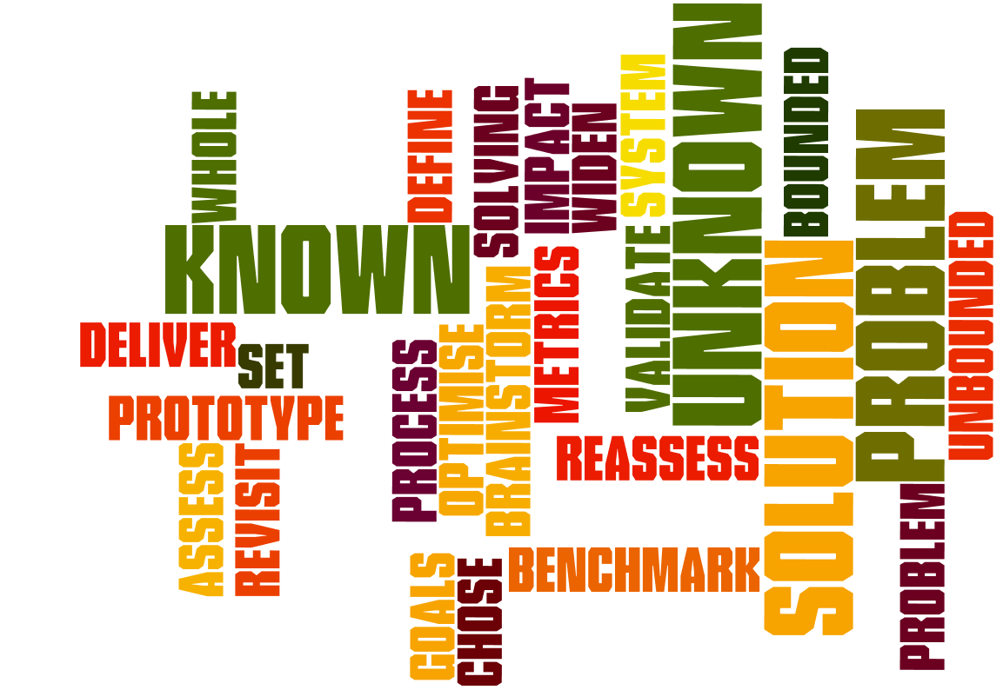
What it means for a Regional Innovation System
The work gives us insight in a number of ways. The concept that micro activity, which in the case of this region, is seen as being contained, closed and fragmented, is so because it is built on the notion of strong ties. Cliques have become quite common, networks are prevalent but generally consist of the same bodies having the same discussions. The strong ties we have forged are now the chains that inhibit and they must be broken and remade.
To develop the RIS we need to be thinking about weak-tie activity, that is social activity that widens the body of people involved, changes the sectorial mix and changes the conversation. To do this we need to embed a series of events that can shift the prevailing culture and start to challenge the current closed innovation system into an open one. We do this by broadening the opportunity for groups to make weak ties.
“Study of the origins and nature (strength and content, for example) of such bridging ties would then offer unusual insight into the social dynamics of the community.” p.1376

Slide 24
Who we are
Relocon is an agitator and change agent to the Regional Innovation System. We currently work in North Essex and South Suffolk – our approach is to help the region to become an open innovation system by being more porous, receptive to knowledge exchange and through a process of trust building established through a curriculum of social learning events, be open and able to change.
We work with the University, with local government, growth hubs and enterprise agencies, funders and most importantly – entrepreneurs.
If you want to know more about our work contact us at info@Relocon.co.uk

